Slide 1
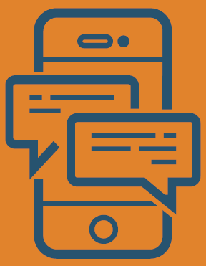

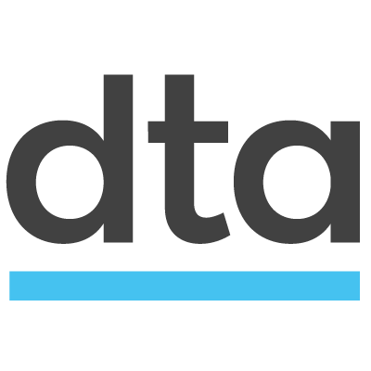
How to make chatbots accessible
5 principles for accessible bot development
Conversational User Interface Community of Practice

Slide 2

A quick recap
In Government we are required to make our web content accessible, we check against WCAG 2.0 AA and WCAG 2.1 AA
9. Make it accessible
Ensure the service is accessible to all users regardless of their ability and environment.
DTA - Digital Service Standard www.dta.gov.au/standard

Slide 3
Assistive technology usage
People using Government online services may use a range of assistive technology which can include:
Screen readers
Screen magnifiers
Voice dictation and navigation

Slide 4
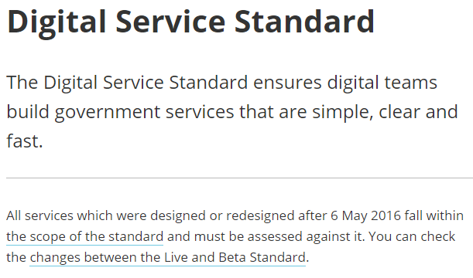
How a screen reader works
Announces onscreen content audibly
"link the scope of the standard"

Slide 5
The problem
Unless web content has been created correctly it can be very difficult and in some instances impossible for an assistive technology user to understand

Slide 6
Caution before use
A well created and maintained accessible website can be undermined by an inaccessible chatbot. Principles for accessible design must be followed

Slide 7
5 accessibility principles
Choose a customisable platform
Ensure conversation history can be navigated
Make the conversation history identifiable
Ensure messages are announced
All rich media must be accessible

Slide 8
1. Customisable platform
Many vendors offer chatbot platforms that include controls to make bots work on your website with minimal code
be wary of these controls

Slide 9
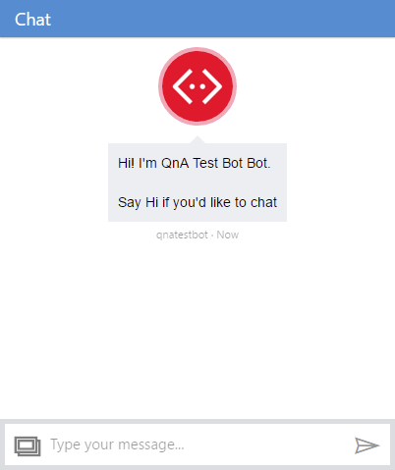
Easy to integrate
Many have poor or non-existent accessibility support
Example. Microsoft bot framework webchat control. If you use this control to talk to your bots, they're probably not accessible

Slide 10
Confirm accessibility support
Test any pre-built chatbot control thoroughly, it may not provide good accessibility support
Test against web accessibility guidelines
Treat claims of 100% accessibility with caution

Slide 11
A good platform
Will allow you to create your own custom UI in HTML and CSS. The closer you get to creating an interface in HTML and CSS, the more accessible it will be

Slide 12
2. Conversation history
Every message must be reachable from the keyboard, some users may use not use a mouse

Slide 13
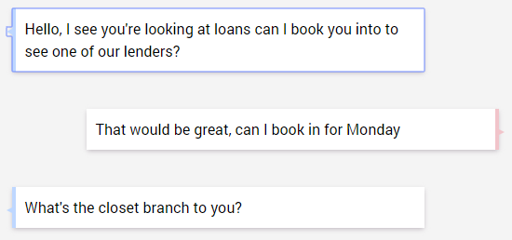
Keyboard focus
Add the attribute tabindex=0 on every message. This means a keyboard user can tab through the conversation history

Slide 14
3. Identifiable conversation
Every message in the conversation must be identifiable. Identify messages from the user and messages from the bot
aria-label="the bot said"
aria-label="you said"

Slide 15

How it looks so far
<div tabindex="0" aria-label="The bot said">
What can I help you with?
</div>
"The bot said what can I help you with"

Slide 16
4. Announce the updates
Use the aria-live attribute to audibly announce new messages

Slide 17
Announcing new messages
When the container has text added to it, only the new text is announced by the screen reader
<div class="conversation-body" aria-live="assertive">
<div tabindex="0" aria-label="The bot said">What can I help you with?</div>
</div>
"What can I help you with?"

Slide 18
Prioritise announcements
A value of assertive announces updates immediately through the screen reader, polite pauses until all other audio has ended
<div class="conversation-body" aria-live="assertive">

Slide 19
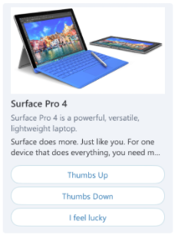
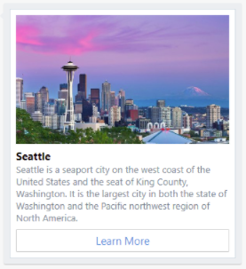
5. Rich media messages
Several bot platforms allow rich media to be returned including images, audio and buttons in addition to plaintext

Slide 20
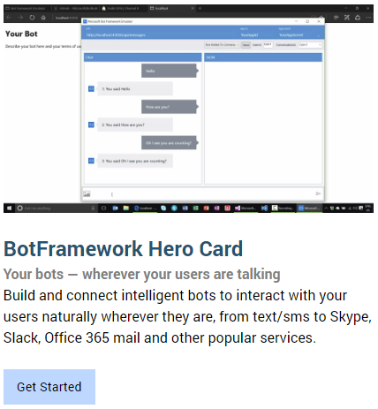
Rich media messages
Also need to be made accessible
Images have appropriate ALT text
Headings are properly structured
Buttons are keyboard accessible
Logical focus order

Slide 21
5 principles + more
Adding accessibility features doesn’t end at these 5 principles

Slide 22
Also think about
Skip links to navigate directly to the chatbot
Conversation is pitched at a suitable age level
Colour contrast
Focus shows the most recent message

Slide 23
Test the results
Test these principles with users to confirm results
Test in browsers
Test different browser versions
Test different assistive technology

Slide 24
Microsoft bot framework
If your skills are .NET based it's one of the better configurable platforms. It supports many channels and plugin services, including intelligence with Cognitive Services

Slide 25
Microsoft bot framework
However avoid using the out-of-the box webchat control provided by Microsoft, as the bots user interface will not be accessible
An accessible UI is achieved by creating your own UI in HTML, CSS, ARIA and Javascript

Slide 26
Cognitive services
Many bot frameworks offer fantastic potential for helping people with disabilities, but if you don’t follow these basic steps all that means little
Before embracing further cutting edge techniques make sure your chatbot is accessible to WCAG 2.0 AA

Slide 27
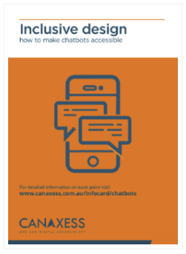


For more information
Get a free information card from www.canaxess.com.au/infocard/chatbots
ross.mullen@canaxess.com.au
MrRossMullen

